Slide 1

Subject: Database Management System
Subject Code:BCS403
Semester : 4
Course Instructors: Prof.Komala Devi,Prof.Abdul Kather, Prof.Jhanvi
Department of Information Science and Engineering,
CMRIT – Bangalore.

Slide 2
DBMS - Module 1
Introduction to Databases
  Introduction
  Characteristics of Data base Approach
  Advantages of using the DBMS approach
  History of database applications.
Overview of Database Languages and Architectures
  Data Models
  Schemas and Instances
  Three Schema Architecture and Data Independence
  Database Languages and Interfaces
Conceptual Data modeling Using Entities and Relationship
Entity Types
Entity sets
Attributes
Roles
Structural Constraints
Weak Entity Types
ER diagrams – Examples
Specialization and Generalization

Slide 3
Introduction
A database is a collection of Related data
Facts that can be recorded and that have implicit meaning

Slide 4
Characteristics of the Database Approach
Self-describing nature of a database system
Insulation between programs and data, and data abstraction
Support of multiple views of the data
Sharing of data and multiuser transaction processing
Self-describing nature of a database system
Database system contains not only the database itself but also a complete definition or description of the database structure and constraints
This definition is stored in the DBMS catalog, which contains information such as the structure of each file, the type and storage format of each data item, and various constraints on the data. The information stored in the catalog is called meta-data, and it describes the structure of the primary database

Slide 5
Insulation between programs and data, and data abstraction
In the file processing, the structure of data files is embedded in the application programs, so any changes to file structure may require changing the application program that access those files.
Whereas DBMS access programs do not require such changes in most cases.
The structure of data files is stored in the DBMS catalog separately from the access programs. We call this property as program-data independence.
The characteristic that allows program-data independence and program-operation independence is called data abstraction.
A DBMS provides users with a conceptual representation of data that does not include many of the details of how the data is stored or how the operations are implemented.

Slide 6
Support of multiple views of the data
A database typically has many types of users, each of whom may require a different perspective or view of the database.
A view may be a subset of the database or it may contain virtual data that is derived from the database files but is not explicitly stored.
A multiuser DBMS whose users have a variety of distinct applications must provide facilities for defining multiple views

Slide 7
Sharing of Data and Multiuser Transaction Processing
This is essential if data for multiple applications is to be integrated and maintained in a single database.
The DBMS must include concurrency control software to ensure that several users trying to update the same data

Slide 8
Advantages of Using the DBMS Approach
Controlling Redundancy
Storing same data multiple times can be avoided
Second, storage space is wasted when the same data is stored repeatedly, and this problem may be serious for large databases
Third, files that represent the same data may become inconsistent.
In the database approach, the views of different user groups are integrated during database design
Restricting Unauthorized Access
When multiple users share a large database, it is likely that most users will not be authorized to access all information in the database.
For example, financial data such as salaries and bonuses is often considered confidential, and only authorized persons are allowed to access such data.
A DBMS should provide a security and authorization subsystem, which the DBA uses to create
accounts and to specify account restrictions.

Slide 9
Providing Persistent Storage for Program Objects
Databases can be used to provide persistent storage for program objects and data structures. This is one of the main reasons for object-oriented database systems
Providing Storage Structures and Search Techniques for Efficient Query Processing
Database systems must provide capabilities for efficiently executing queries and updates. Because the database is typically stored on disk, the DBMS must provide specialized data structures and search techniques to speed up disk search for the desired records.
The query processing and optimization module of the DBMS is responsible for choosing an efficient query execution plan for each query based on the existing storage structures.

Slide 10
Providing Backup and Recovery
A DBMS must provide facilities for recovering from hardware or software failures. The backup and recovery subsystem of the DBMS is responsible for recovery.
Providing Multiple User Interfaces
Because many types of users with varying levels of technical knowledge use a database, a DBMS should provide a variety of user interfaces. These include apps for mobile users, query languages for casual users, programming language interfaces for application programmers, forms and command codes for parametric users, and menu-driven interfaces and natural language interfaces for standalone users.

Slide 11
Representing Complex Relationships among Data
A DBMS must have a capability to represent variety of complex relationships among the data, to define the new relationship.
Enforcing Integrity Constraints
A DBMS may have certain integrity constraints, and the DBMS should capable of enforcing these constraints.
Eg., Relationship between two tables. If deleting data from one table, it should immediately reflect on the other table.
Ex2. Key constraint, Integrity Constraint, etc.,
Permitting Inferencing and Actions Using Rules and Triggers
Some Database system provide capabilities for defining deduction rules for inferencing new information from the stored database facts. (Instead of writing declarative rules, we can use triggers)

Slide 12
Additional Implications of Using the Database Approach
  Potential for Enforcing Standards
  Reduced Application Development Time
  Flexibility
  Availability of Up-to-Date Information
  Economies of Scale

Slide 13
A Brief History of Database Applications
Early Database Applications Using Hierarchical and Network Systems
Eg., In University application, similar information would be kept for each student, each grade, each course. Here, there are many types of data and interrelationships among them.
Intermixing of conceptual relationship with the physical storage and placement of records on disk.
Providing Data Abstraction and Application Flexibility with Relational Databases
  Data abstraction and program-data independence were much improved when compared to earlier systems

Slide 14
Object-Oriented Applications and the Need for More Complex Databases
  abstract data types, encapsulation of operations, inheritance, and object identity
Interchanging Data on the Web for E-Commerce Using XML
  Documents can be linked through hyperlinks, which are pointers to other documents
Extending Database Capabilities for New Applications
  Scientific, Storage and retrieval of images, Data mining, Spatial, Time series
Emergence of Big Data Storage Systems and NOSQL (Not-Only SQL) Databases

Slide 15
Database System Concepts and Architecture
Data Models, Schemas, and Instances
Data abstraction generally refers to the suppression of details of data organization and storage, and the highlighting of the essential features for an improved understanding of data One of the main characteristics of the database approach is to support data abstraction so that different users can perceive data at their preferred level of detail
A data model—a collection of concepts that can be used to describe the structure of a database By structure of a database we mean the data types, relationships, and constraints that apply to the data. Most data models also include a set of basic operations for specifying retrievals and updates on the database.
Include concepts in the data model to specify the dynamic aspect or behavior of a database application

Slide 16
Categories of Data Models
High-level or conceptual data models provide concepts that are close to the way many users perceive
data, whereas low-level or physical data models provide concepts that describe the details of how data is stored on the computer storage media, typically magnetic disks.
Conceptual data models use concepts such as entities, attributes, and relationships. An entity represents a real-world object or concept.
An attribute represents some property of interest that further describes an entity, such as the employee’s name or salary.
Entity–relationship model—a popular high-level conceptual data model. A relationship among two or more entities represents an association among the entities.
Other Data models are
Relational data model, as well as the so-called legacy data models—the network and hierarchical models, and object data model (OMG) Object Data Management Group (ODMG)

Slide 17
Schemas, Instances, and Database State
The description of a database is called the database schema A displayed schema is called a displayed schema is called a schema diagram
Student
Name | Student_Number | Class | Major
Course
Course_Name | Course_Number | Credit_Hours | Department
Prerequisite
Course_Number | Prerequisite_Number

Slide 18
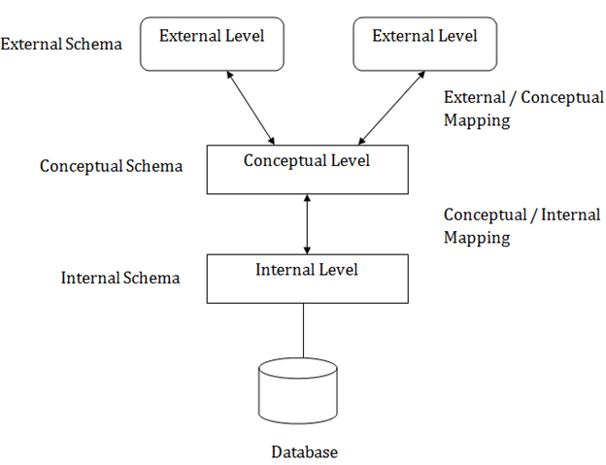
Three-Schema Architecture and Data Independence
The internal level has an internal schema, which describes the physical storage structure of the database. The internal schema uses a physical data model and describes the complete details of data storage and access paths for the database.

Slide 19
The conceptual level has a conceptual schema, which describes the structure of the whole database for a community of users. The conceptual schema hides the details of physical storage structures and concentrates on describing entities, data types, relationships, user operations, and constraints.
The external or view level includes a number of external schemas or user views. Each external schema describes the part of the database that a particular user group is interested in and hides the rest of the database from that user group.

Slide 20
Data Independence
Logical data independence is the capacity to change the conceptual schema without having to change external schemas or application programs. We may change the conceptual schema to expand the database (by adding a record type or data item), to change constraints, or to reduce the database.
Physical data independence is the capacity to change the internal schema without having to change the conceptual schema. Hence, the external schemas need not be changed as well.

Slide 21
Database Languages and Interfaces
DDL – Data Definition Languages – used by DBA and by database designers to schemas
DML – Data Manipulation Language – Manipulations include retrieval, insertion, deletion, and modification of the data
SDL – Storage Definition Language – is used to specify internal schema
Menu-based Interfaces for Web Clients or Browsing Apps for Mobile Devices
Forms-based Interfaces
Graphical User Interfaces
Natural Language Interfaces
Keyword-based Database Search
Speech Input and Output
Interfaces for Parametric Users
Interfaces for the DBA
DBMS Interfaces

Slide 22
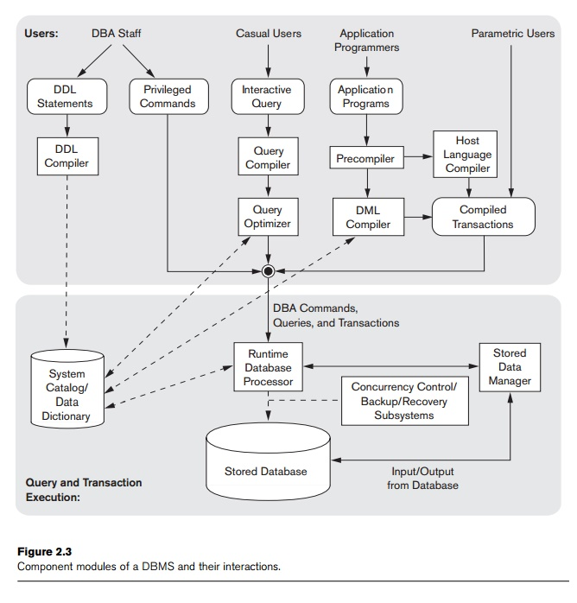
The Database System Environment

Slide 23
Database System Utilities
Loading – Loading utility is used to load existing data files—such as text files or sequential files—into the database
Backup – Backup utility creates a backup copy of the database, usually by dumping the entire database onto tape or other mass storage medium.
Database storage reorganization – This utility can be used to reorganize a set of database files into different file organizations and create new access paths to improve performance.
Performance monitoring – Such a utility monitors database usage and provides statistics to the DBA.

Slide 24
Tools, Application Environments, and Communications Facilities
Data dictionary
Information Repository
Application Development Environment
Communication Software

Slide 25
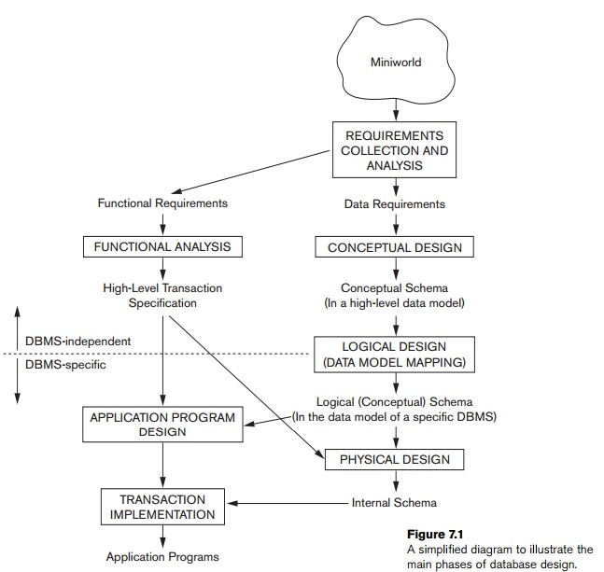
Data Modeling Using the Entity–Relationship (ER) Model
Using High-Level Conceptual Data Models for Database Design
The first step is requirements collection and analysis.
The database designers interview prospective database users to understand and document their data requirements.
Describe functional requirements and User defined operations
Create a conceptual schema for the database, using a high-level conceptual data model – is known as Conceptual design.

Slide 26
A Sample Database Application
COMPANY - Database
We list the data requirements for the database here, and then create its conceptual schema step-by-step as we introduce the modeling concepts of the ER model.
The COMPANY database keeps track of a company’s employees, departments, and projects.
The company is organized into departments. Each department has a unique name, a unique number, and a particular employee who manages the department. We keep track of the start date when that employee began managing the department. A department may have several locations.
A department controls a number of projects, each of which has a unique name, a unique number, and a single location.
The database will store each employee’s name, Social Security number, address, salary, gender, and birth date. An employee is assigned to one department, but may work on several projects, which are not necessarily controlled by the same department.
The database will keep track of the dependents of each employee for insurance purposes, including each dependent’s first name, gender, birth date, and relationship to the employee.

Slide 27
Entity Types and Entity Sets - A database usually contains groups of entities that are similar.
An entity type describes the schema or intension for a set of entities that share the same structure (Employee Entities). The collection of entities of a particular entity type is grouped into an entity set, which is also called the extension of the entity type.
Key Attributes of an Entity Type
An important constraint on the entities of an entity type is the key or uniqueness constraint on attributes.
key attribute - An entity type usually has one or more attributes whose values are distinct for each individual entity in the entity set

Slide 28
Composite versus Simple (Atomic) Attributes
Composite attributes can be divided into smaller subparts, which represent more basic attributes with independent meanings.
Attributes that are not divisible are called simple or atomic attributes
Single-Valued versus Multivalued Attributes - attributes have a single value for a particular entity & a attribute having multiple value is multivalued attributes.
Stored versus Derived Attributes – Date of Birth & Age
NULL Values
Complex Attributes - Composite and multivalued attributes can be nested arbitrarily

Slide 29
Schema – Student (USN, Name, DoB, Mobile No)
USN | Name | DoB | Mobile No
1CR19IS001 | ABCD | 8/02/1990 | 1254785842
1CR19IS002 | EFGH | 7/04/1991 | 1254857254
1CR19IS003 | IJKL | 1/09/1992 | 5257845236
1CR19IS004 | MNOP | 14/03/1991 | 8754985671

Slide 30
ER – Diagram
Rectangle: Represents Entity sets.
Ellipses: Attributes
Diamond: Relationship Set
Double Diamond: Identifying Relationship
Lines: They link attributes to Entity Sets and Entity sets to Relationship Set
Double Ellipses: Multivalued Attributes
Dashed Ellipses: Derived Attributes
Double Rectangles: Weak Entity Sets
Double Lines: Total participation of an entity in a relationship set

Slide 31
Components of a ER Diagram
ER Model
Entity
Attribute
Relationship
key
One-to-One
Composite
One-to-Many
Multivalued
Many-to-One
Weak Entity
Derived
Many-to-Many

Slide 32
NUMBER
LOCATIONS | NAME | NUMBER | MANAGER | MANAGER_START_DATE
NAME
MANAGER
DEPARTMENT
LOCATIONS
MANGER_START_DATE
LOCATIONS
Number
Name
Controlling_department
LOCATIONS | NAME | NUMBER | Controlling Departments
PROJECT
LOCATIONS
Location

Slide 33
LName
Minit
Salary
FName
Name
Aadhar
Gender
Department
Employee
Birth_Date

Slide 34
The Company Organized into departments. Each dept. has a unique name, number, and who manages the dept.(employee), and date he manages the dept.
Department controls ‘n’ number of projects. Each dept. has unique name, number, and single location.
Employee – name, Aadhar, address, salary, gender, and DOB
An employee may associate with dept. but may work on several projects

Slide 35
Relations: - Company Databases
EMPLOYEE DEPARTMENT
  SUPERVISION - EMPLOYEE CONTROLS - PROJECT
  WORKFOR - DEPARTMENT
  MANAGES - DEPARTMENT
  WORKS ON - PROJECT
  DEPENDENTS_OF - DEPENDENT

Slide 36
Relationship Types, Relationship Sets, Roles, and Structural Constraints
Whenever an attribute of one entity type refers to another entity type, some relationship exists.
For example, the attribute Manager of DEPARTMENT refers to an employee who manages the department
attribute Controlling_department of PROJECT refers to the department that controls the project
In the ER model, these references should not be represented as attributes but as relationships
Relationship Types, Sets, and Instances
A relationship type R among n entity types E1, E2, . . . , En defines a set of associations— or a relationship set—among entities from these entity types.
Similar to the case of entity types and entity sets, a relationship type and its corresponding relationship set are customarily referred to by the same name, R.

Slide 37
Relationship – Mapping Cardinality
A relationship is represented by diamond shape in ER diagram, it shows the relationship among entities. There are four types of relationships
There are four types of relationships
1. One to One
2. One to Many
3. Many to One
4. Many to Many

Slide 38
1. One to One Relationship
When a single instance of an entity is associated with a single instance of another entity then it is called one to one relationship. For example, a person has only one passport and a passport is given to one person.
Person
1
has
Phone
1

Slide 39
One to Many Relationship
When a single instance of an entity is associated with more than one instances of another entity then it is called one to many relationship. For example – a customer can place many orders but a order cannot be placed by many customers
Customer
1
Placed
Order
M

Slide 40
Many to One Relationship
When more than one instances of an entity is associated with a single instance of another entity then it is called many to one relationship. For example – many students can study in a single college but a student cannot study in many colleges at the same time.
Students
M
Study
College
1

Slide 41
Many to Many Relationship
When more than one instances of an entity is associated with more than one instances of another entity then it is called many to many relationship. For example, a can be assigned to many projects and a project can be assigned to many students
Student
M
Assigned
Project
M

Slide 42
Total Participation of an Entity set
A Total participation of an entity set represents that each entity in entity set must have at least one relationship in a relationship set. For example: In the below diagram each college must have at-least one associated Student
S_Name
S_addr
Col_id
Col_name
USN
Student
StudyIN
College

Slide 43
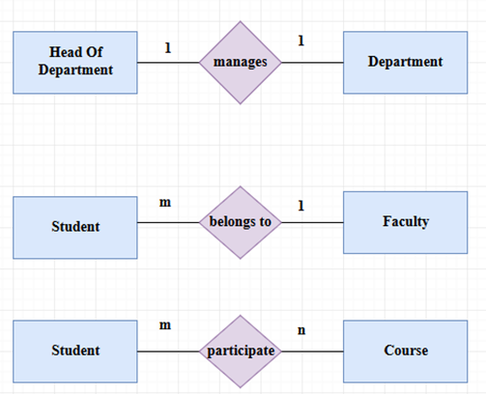
The main difference between entity and relationship in DBMS is that the entity is a real-world object while the relationship is an association between the entities.
A rectangle represents an entity in the ER diagram.
A double rectangle represents a weak entity
Oval represents the attributes of an entity

Slide 44
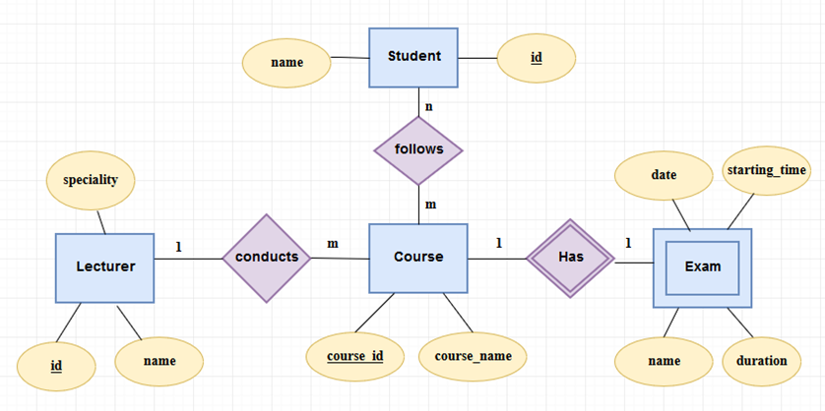

Slide 45
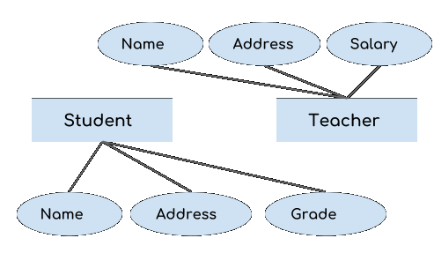
Generalization is a process in which the common attributes of more than one entities form a new entity. This newly formed entity is called generalized entity
Lets say we have two entities Student and Teacher.
Attributes of Entity Student are: Name, Address & Grade
Attributes of Entity Teacher are: Name, Address & Salary
These two entities have two common attributes: Name and Address, we can make a generalized entity with these common attributes. Lets have a look at the ER model after generalization

Slide 46
We have created a new generalized entity Person and this entity has the common attributes of both the entities. As you can see in the given ER Diagram that after the generalization process the entities Student and Teacher only has the specialized attributes Grade and Salary respectively and their common attributes (Name & Address) are now associated with a new entity Person which is in the relationship with both the entities (Student & Teacher)
Name
Person
Address
Is A
Grade
Salary
Student
Teacher

Slide 47
1. Generalization uses bottom-up approach where two or more lower level entities combine together to form a higher level new entity.
2. The new generalized entity can further combine together with lower level entity to create a further higher level generalized entity.

Slide 48
Specialization
Name
Employee
Salary
Specialization is a process in which an entity is divided into sub-entities. You can think of it as a reverse process of generalization, in generalization two entities combine together to form a new higher level entity. Specialization is a top-down process
Is A
Technician
Engineer
Accountant
Service
Project
Credit_Debit

Slide 49
Specialization is to find the subsets of entities that have few distinguish attributes. For example – Consider an entity employee which can be further classified as sub-entities Technician, Engineer & Accountant because these sub entities have some distinguish attributes.

Slide 50
Text books and Reference books
Text Books
1. | Fundamentals of Database Systems, Ramez ElmasriandShamkantB.Navathe,7thEdition,2017,Pearson. ISBN: 978-0-13-397077-7
2. | Databasemanagementsystems,Ramakrishnan,andGehrke,3rdEdition,2014, McGrawHill ISBN-10: 0072465638
Reference Books
 | Silberschatz Korth and Sudharshan, Database System Concepts, 6th Edition,Mc-GrawHill,2013. ISBN-10: 9332901384
2. | Coronel, Morris, and Rob, Database Principles Fundamentals of Design, Implementation and Management, Cengage Learning2012. ISBN 9781285196145

Slide 51
Some useful links
https://www.cs.uregina.ca/Links/class-info/215/erd/#:~:text=Data%20modeling%20is%20a%20technique,data%20requirements%20for%20a%20database
https://www.geeksforgeeks.org/generalization-specialization-and-aggregation-in-er-model/
https://www.guru99.com/relational-data-model-dbms.html
https://www.tutorialspoint.com/dbms/relational_algebra.htm

Slide 52
Thank You

